Slide 1
TFT Display & Touch Panel
Prepared by:
Omar Samir

Slide 2
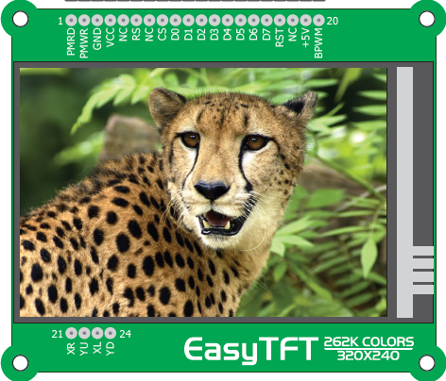
About TFT
Color Display
320 x 240 pixels
262.144 different colors
Connected to microcontroller PORTE using standard 8080 parallel 8-bit interface
Brightness control via PWM signal

Slide 3
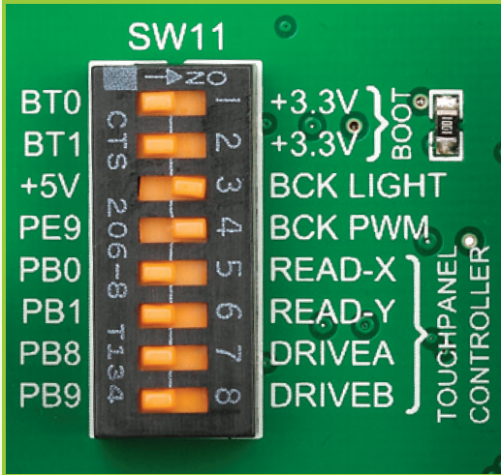
Enable TFT
Turn on switches
SW11.3
SW11.4

Slide 4
About Touch Panel
Comes as a part of TFT 320x240 display
A glass panel whose surface is covered with two layers of resistive material
When the screen is pressed, the outer layer is pushed onto the inner layer and appropriate controllers can measure that pressure and pinpoint its location
The pressed coordinates can be converted to X and Y values

Slide 5
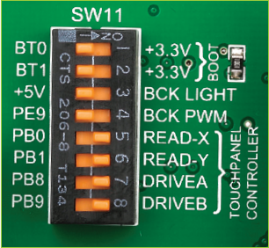
Enable Touch Panel
Enable pins 5, 6, 7, 8 in SW11

Slide 6
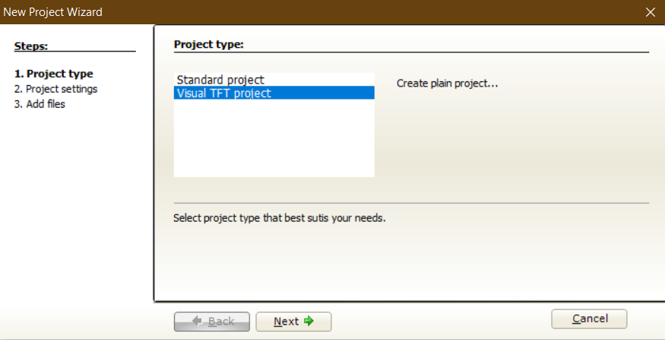
Starting Visual TFT project
Open MikroC for ARM
Click on New Project
Select Visual TFT project
Click Next

Slide 7
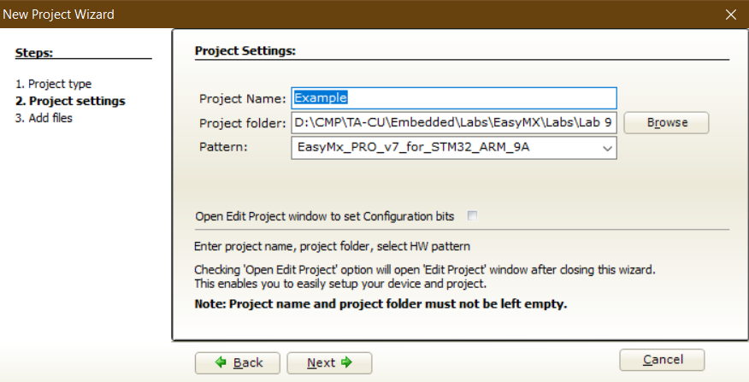
Starting Visual TFT project

Slide 8
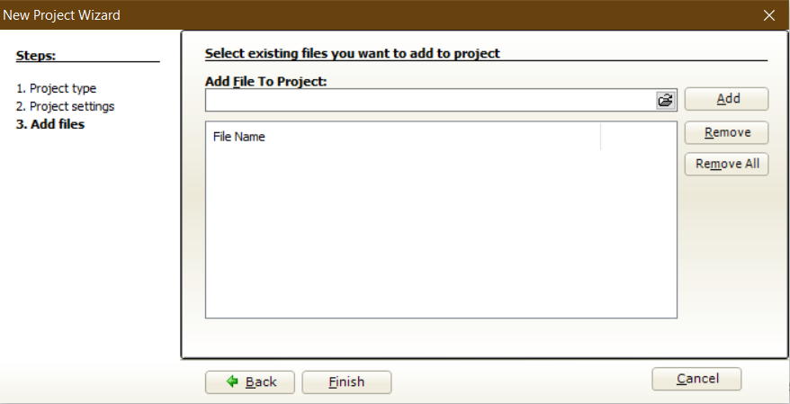
Starting Visual TFT project
Click Finish
It will generate all required files for the project

Slide 9
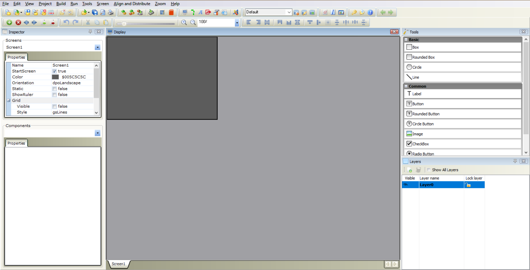
Starting Visual TFT project
It will open the Visual TFT window where you can design your TFT display.
Use F12 to switch between the Visual TFT window and the code window

Slide 10
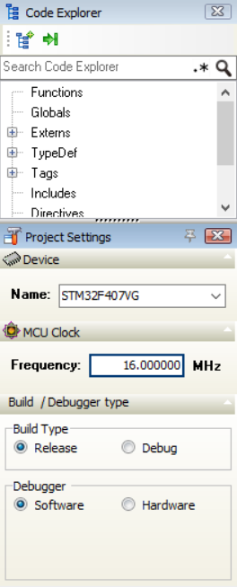
Starting Visual TFT project
Change the device and MCU Clock in the Project Settings to:
STM32F407VG
16 MHz
By this step we are ready to use the TFT display

Slide 11

Visual TFT Window
Your design should be here
Choose components
Control screens properties
Controls components properties

Slide 12
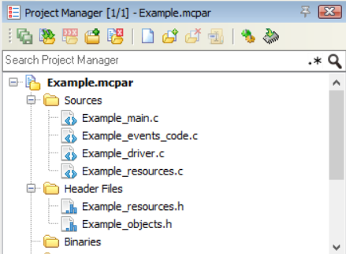
Code Files
Visual TFT project generates all necessary source and header files
It uses MikroC TFT library and Touch Panel library

Slide 13
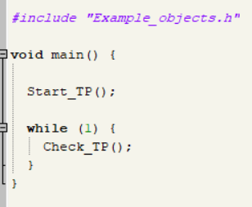
*_main.c
This file contains the main function.
Start_TP() does all necessary configurations
The ordinary while loop of the program
Check_TP() checks if the touch panel is pressed and does any necessary event handling

Slide 14
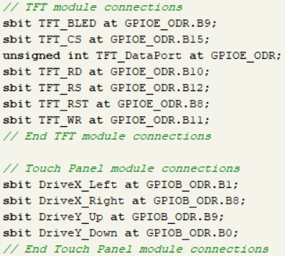
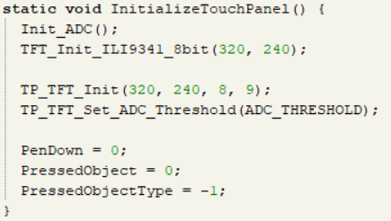
*_driver.c
This file contains all configuration, objects and drawing functions.
Initialize TFT and touch panel connections
Initialize the TFT resolution

Slide 15
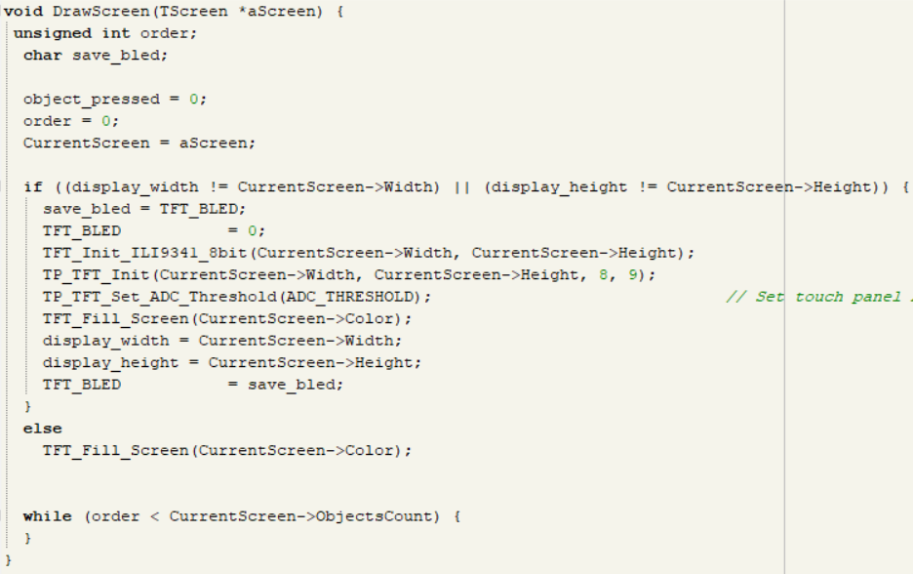
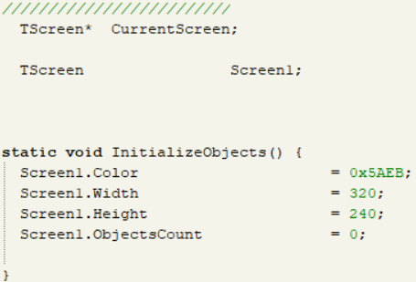
*_driver.c
Create and initialize Screen Object
DrawScreen Function

Slide 16
*_resouces.c
Contains any resources to be displayed like images.

Slide 17
*_event_codes.c
Contains event handlers of touch panel to handle pressing, clicking, etc..

Slide 18
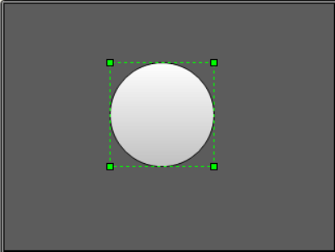
Display Circle Example
In the Visual TFT window drag and drop a circle from the Tools on the display

Slide 19
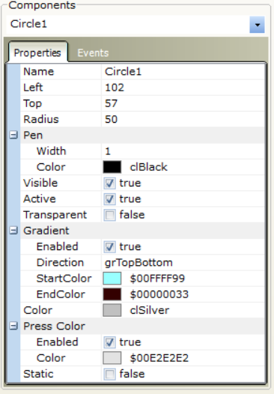
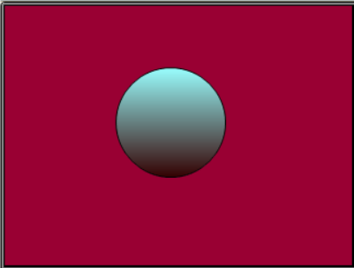
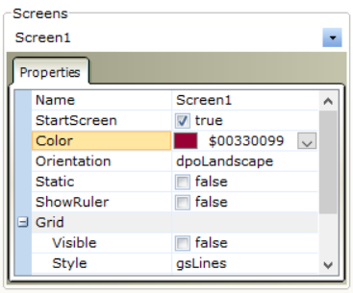
Display Circle Example
Change the Circle colors from components -> properties
Change the screen color From screens -> properties

Slide 20
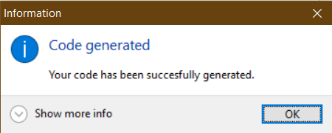
Display Circle Example
Go to code window by pressing F12

Slide 21
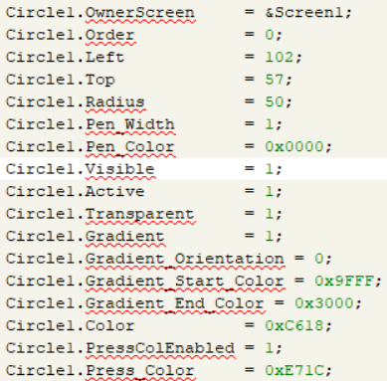
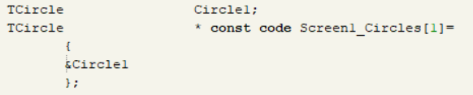
Display Circle Example
In *_driver.c you will find all code of the circle added

Slide 22
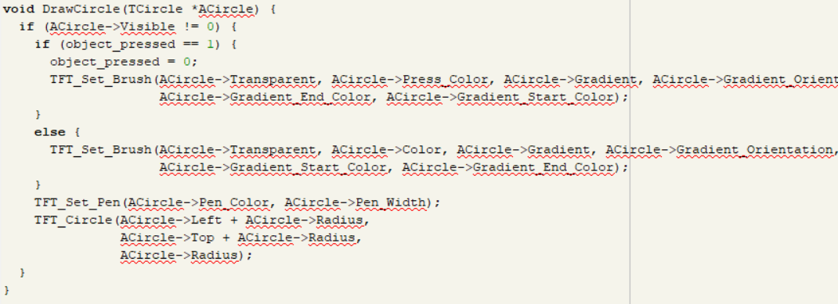
Display Circle Example
In *_driver.c you will find all code of the circle added

Slide 23
Display Circle Example
Build and Program the project
The screen will appear successfully on the TFT

Slide 24
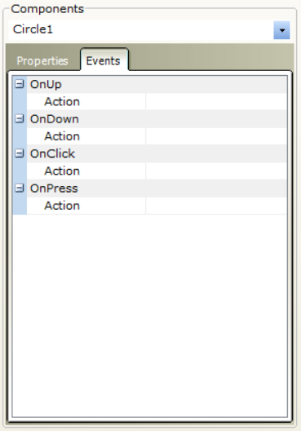
Touch Panel Example
Now lets handle if the Circle is pressed.
Select the circle in the visual TFT window
Click on Events in Components
We will work with the following actions
onClick: when the object is clicked and released
onPress: when the object is pressed (keep working while pressing)

Slide 25
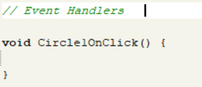
Touch Panel Example
Double click beside on the action you need (onClick in our example)
The project will redirect you to Example_events_code.c
It will create empty function to place your logic in

Slide 26
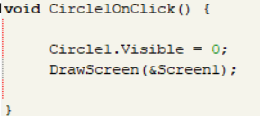
Touch Panel Example
In the circle Handler here we set the visibility of the circle to be zero
Redraw the screen again to see the effect

Slide 27
Touch Panel Example
Build and Program the project
The screen will appear successfully on the TFT
When the circle is pressed it disappears

Slide 28
Requirements

Slide 29
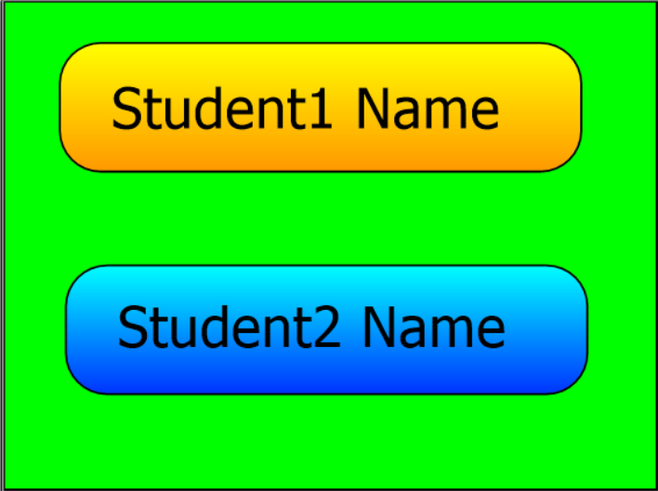
Requirement 1
It is required to draw the given screen with your names. The background color should be green. Place your names in round boxes with corner radius = 20. Type your names with font size = 20.

Slide 30

Requirement 2
It is required to display the egyptian flag on the screen. You are given a JPEG image of the eagle. Complete on the same project by adding new screen from the + button in the toolbar.
Steps:
Add Red Box
Add white Box
Add black Box
Add the eagle image
Hints:
Check which screen to be called in Start_TP()

Slide 31
Requirement 3
It is required to use PC0 as input pin to switch between Requirement one and two screens. The transition must happen on the rising edge.
Hints:
Use DrawScreen() in the main function to do the switch

Slide 32
Requirement 4
It is required to make your names clickable. When Student1 Name is clicked all PORTD pins are turned on. When Student2 Name is clicked all PORTD pins are turned off.

